Slide 1
Capstone Project
Credit Card Fraud Detection using Machine Learning Techniques
Name:-Prashant Amrao

Slide 2
Flow of Talk
Introduction
Experimental Setup and Method
Performance Evaluation and Result
Conclusion
Reference

Slide 3
Introduction
Fraud can be defined as criminal deception with intent of aquiring financial gain.
Credit Card Fraud
Inner Card fraud:-Done by using false Identity
External Card Fraud:-Done by Using stolen credit card
How Frauds are Recognized
Location
Items you buy
Frequency
Amount

Slide 4
Challenges
The data is highly skewed.
Normal Machine learning algorithms would give 99% +Accuracy.
But we can get 99.8% accuracy even if we classify all frauds as legitimate.

Slide 5
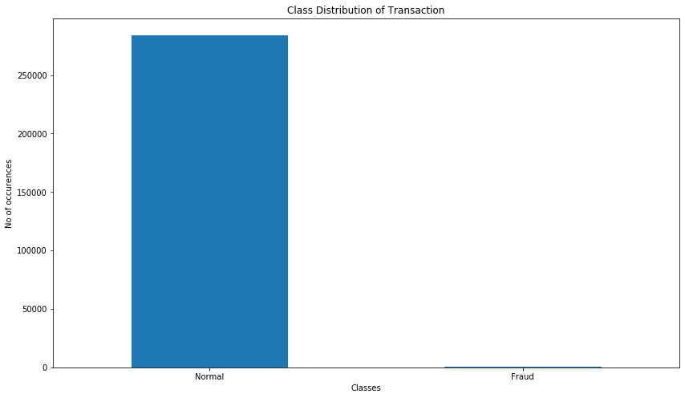
Exploratory Data Analytics

Slide 6
Experimental Setup and Method
Dataset
Sourced from Kaggle Machine Learning Group
Consisting 2,84,807 transactions, and in that (632) 0.172% fraud cases.
Highly unbalanced and skewed towards fraud class

Slide 7
Algorithm Applied
Logistic Regression
Form of regression that allows the prediction of discrete variables by a mix of continuous and discrete predictors.
Addresses the same questions that discriminant function analysis and multiple regression do but with no distributional assumptions on the predictors (the predictors do not have to be normally distributed, linearly related or have equal variance in each group)

Slide 8
Continued…
We can also evaluate on the below algorithms
K- Nearest Neighbours and
Logistic Regression
Performance of naïve bayes, K-nearest neighbour and logistic regression classifier are evaluated based on:
Accuracy
Sensitivity
Specificity
Precision

Slide 9
Conclusion
The highly imbalanced dataset is sampled in a hybrid approach where the positive class is oversampled and the negative class under-sampled, achieving two sets of data distributions.
The performances of the three classifiers are examined on the two sets of data distributions using accuracy, sensitivity specificity, precision, balanced classification rate and Matthews Correlation coefficient metrics.
Results from the experiment shows that the KNN shows significant performance for all metrics evaluated except for accuracy in the 10:90 data distribution.

Slide 10
Thank-You

